Slide 1
Mensa
What’s IQ Got To Do With It?
Michael Eager
Region 8 Vice Chair
Pacific Intermountain Region
rvc8@us.mensa.org
Notes:
Hi, I'm Michael Eager.
I want to thank Nelson and the Rotary Club for inviting me to give a brief introduction to Mensa.
I’ve been a member of Mensa since 1977. I recently completed a 12-year stint as president of the San Francisco chapter. In July, I was elected to American Mensa's board of directors as representative for the Pacific Intermountain Region, extending from Northern California to Alaska to Montana.
I’ll start with the origin of Mensa, my experience of the club, and then talk about some of the things we do.

Slide 2
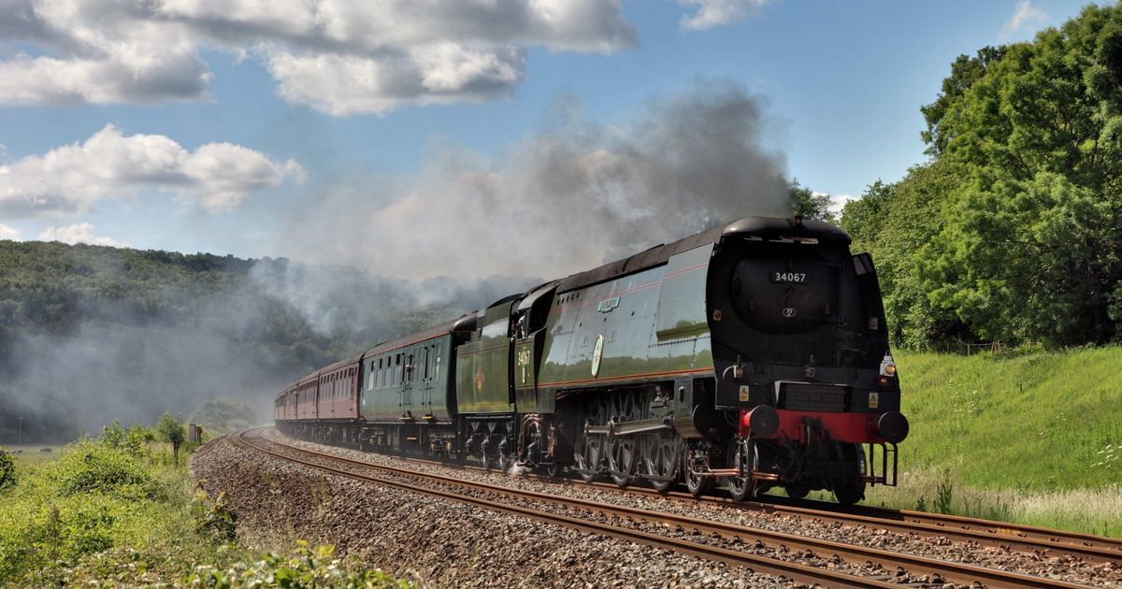
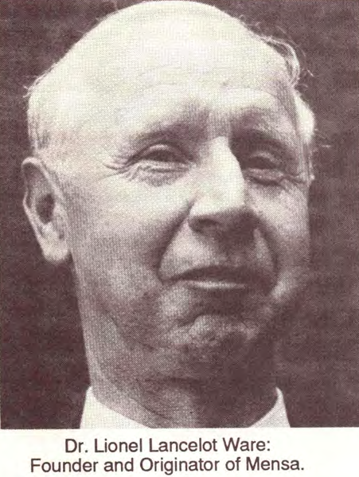
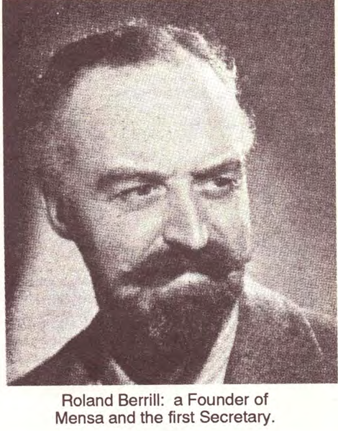
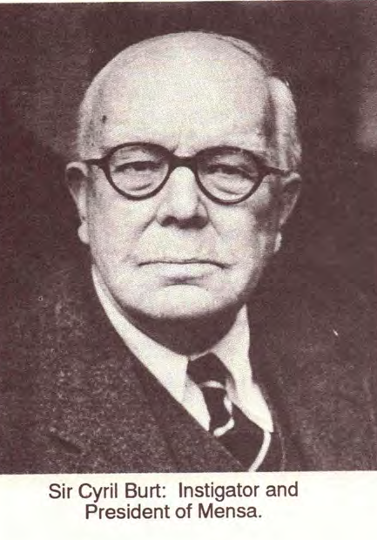
A Chance Meeting
Surry, England, 1945 Chance Meeting
Notes:
Mensa started as a chance meeting on a train in Surry, England, shortly after the end of World War II.
Lancelot Ware, 30, a biochemist was studying law at Oxford.
Roland Berrill, 45, an ex-pat Australian, was also a lawyer but more an investor and eccentric.
They started talking about Oxford and intelligence, testing vs observation. Berrill thought that he could tell how intelligent someone was by talking with them. Ware had a more analytical approach and had been giving the Cattell IQ test to friends and his sister.
There was the person not in the room: Ware and Berrill discussed talks given by Sir Cyril Burt on BBC. He was a well-known psychologist doing research on heredity and intelligence. One of Burt's talks may (or maybe didn't) advocate for creating a group of highly intelligent people to solve Britain's post war problems.
By the way, Lance Ware attended the San Francisco Annual Gathering in 1992 where we became acquainted and I had the opportunity to interview him for an hour.

Slide 3
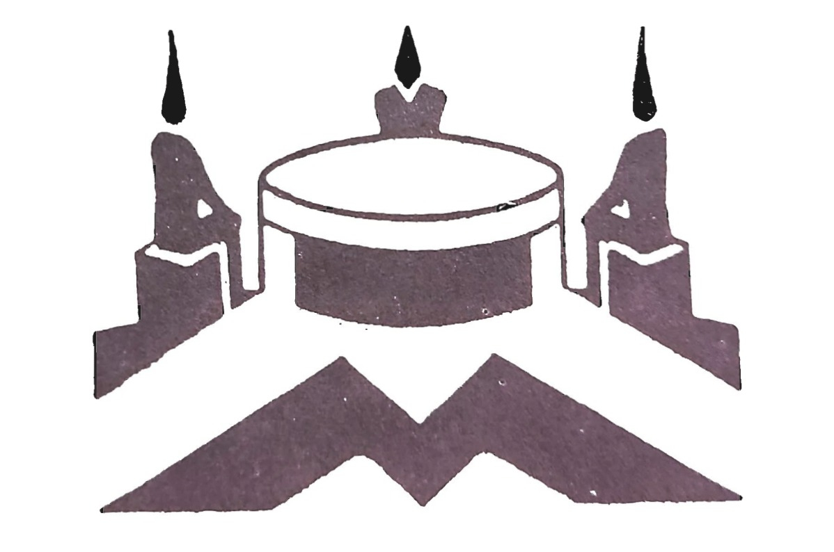
Founding Mensa
March, 1946 — Ware gives Berrill Cattell IQ test
    Berrill scores in top 1%
October 1, 1946 — First publication mentioning Mensa
    Taken as founding date
    Berrill named Mensa
      Latin for Mind, Table, Month
Social organization
Qualification set at top 1%
Advertising and growth in 50’s
Notes:
Ware and Berrill exchanged contact information and in March, 1946, they met and Ware gave Berrill the Cattell IQ test. Berrill scored in the top 1% (apparently to Lance's surprise).
They discussed creating a club for high-IQ people, similar to some clubs at Oxford and other universities. Berrill pursued this idea aggressively, naming the group "Mensa", Latin for “mind” table” and “month”, publishing the first piece of Mensa literature, getting free advertising, and promoting membership in the newly formed group.
This is the original logo, people around a table with minds a flame. Or something.
While Berrill was a great promoter, he wasn't a great organizer. The group foundered for a while and nearly disappeared. Ware let his membership lapse. Mensa picked up steam in the mid-50's under the guidance of Victor Serebriakoff. By 1960, 180 people attended the Annual Gathering.

Slide 4
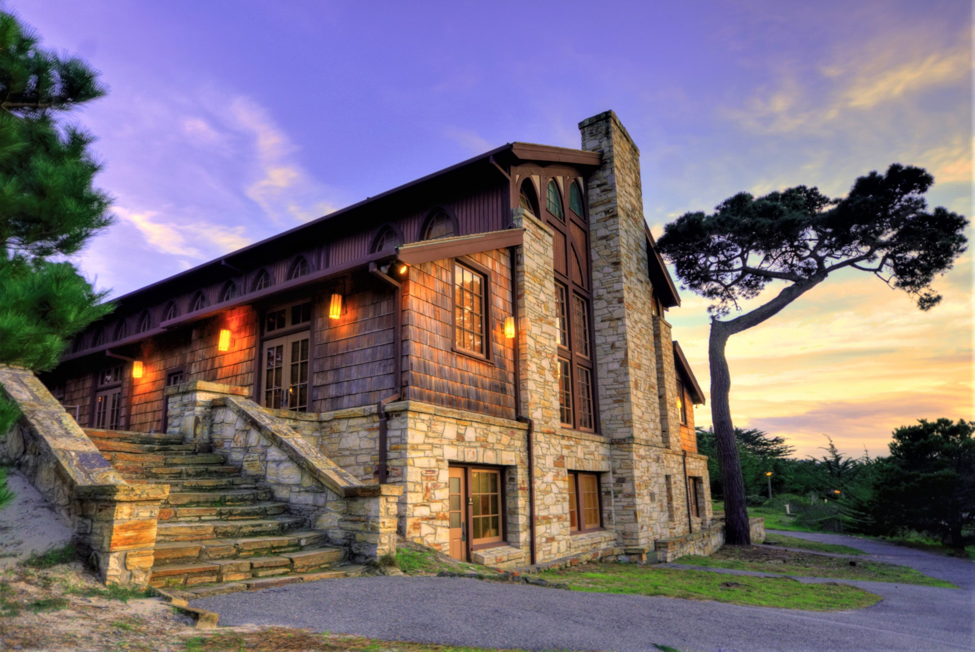
The Roaring 60’s
1960 — Article in Village Voice
1961 — 50 North American Mensa members
    American Mensa Selection Agency created
    First American Mensa newsletter
    Qualification level set at top 2%
1962 — 30 Local Mensa Groups in US
    Bay Area Mensa publishes Chiaroscuro
1963 — Mensans in 40 countries
    First American Mensa Annual Gathering in NYC
1965 — First Mensa Asilomar
    Model for Regional Gatherings around the US
Notes:
The 1960's saw the growth and expansion of Mensa from a British organization with a smattering of non-Brit members, to an international organization with members in 40 countries. Interest in Mensa spread across the United States and there were many people who met to start local chapters.
I know two people who claim to have been at the first Mensa meeting in San Francisco, and who both claim that the other was not there. There seems to have been more than one "first meeting".
Monterey County Mensa and San Francisco organized the first Mensa Asilomar at the Asilomar Conference Grounds in Pacifica Grove. This became the model for Regional Gatherings around the US, with speakers, hospitality suites, a costume party, casino, and beach Olympics.

Slide 5

Mensa Constitution — 1964
Objectives
  Identify and foster human intelligence for the benefit of humanity
  Encourage research on the nature, characteristics, and uses of intelligence
  Provide a stimulating intellectual and social environment for members.
Organization
  Establish Mensa International Ltd, in England
  Create independent national Mensa organizations
    British Mensa, American Mensa, Mensa in Deutschland, etc.
Notes:
It had taken almost two decades, but finally, Mensa created a constitution with clear objectives for the organization. Mensa International Ltd was incorporated in England, where it is today, as an umbrella organization over dozens of national Mensa organizations, as well as for direct international members.
The old, somewhat strange logo was replaced by a more modern logo. You can still see the table if you squint.

Slide 6

American Mensa
18 Local groups recognized — Dec/Jan 1964-5
San Francisco Regional Mensa
    First newsletter — 1964
    Official founding date October, 1965
1970 — 10,000 members
1980 — 1000 people at SF AG
1990 — 56,000 members
Notes:
American Mensa took off in the 1970's and 1980's. A 1979 article in Reader's Digest, including a mini-test, brought in thousands of new members. More that 1000 people attended the San Francisco Annual Gathering in 1980 (which was also my first).
"The Women of Mensa" article in Playboy Magazine in 1985 brought in more. Three female Mensan approached American Mensa’s Publications Officer, Al Zemsky, and said they didn’t want to be known as dumb blonds. Al worked with Playboy to make sure there was a mini-IQ test included in the article. By the way, since glasses are a guaranteed give-away that someone is smart, in the opening layout all seven women are wearing heavy black-framed glasses. Of course, glass reflects flash badly, so none of the frames actually contained lenses.
American Mensa soon became the largest of the national Mensa groups.

Slide 7
My Introduction to Mensa
New job in downtown San Francisco – July, 1977
Article in mid-week SF Chronicle about SFRM
Activities
    Lunch group at Hang Ah Tearoom in Chinatown
    House parties and first pool party
    Mensa Asilomar
    Tuesday afternoon bar group
    Sunnyvale lunch bunch
    Real estate investment SIG
    MAY — Mensans at Yosemite camping
Notes:
I moved from Chicago to San Francisco in 1977. There were many differences, and a bit of culture shock. In Chicago you don’t need to wear a sweater in July.
I didn’t know anyone in the area. Although I joined Mensa in Chicago, I had never been to a meeting. I started going to a small lunch group at the Hang Ah Tearoom (which is still there!) then to my first clothing-optional pool party. Lots of culture shock for a Midwesterner.
I attended Mensa Asilomar. This gathering attracted over 400 Mensans for speakers, a casino, beach Olympics and much more. I was hooked.
The SFRM calendar soon became my social calendar. I was shy, under 30, maybe a bit awkward. Mensa members welcomed me into their conversations. Some were polymaths, some had great stories, some were older, and some were, well, boring. There was a feeling, one that I’ve experienced at many Mensa meetings around the world, of belonging. I wasn’t an outsider; I was part of the Mensa family.

Slide 8
Volunteering
Area Secretary for South Bay
Scribe (Secretary) for SFRM
Co-chair Regional Gathering at SF Fairmont Hotel
Edit SFRM Intelligencer and Ecphorizer
Chocolate tastings at Wine Country Regional Gathering
and 1992 SF Annual Gathering
Elected Local Secretary — 1993
Chair Mensa Asilomar 32 – The Global Village — 1996
Notes:
I soon became very involved with San Francisco Regional Mensa, volunteering for a number of different positions.
I still do chocolate tastings at all of our Regional Gatherings.

Slide 9
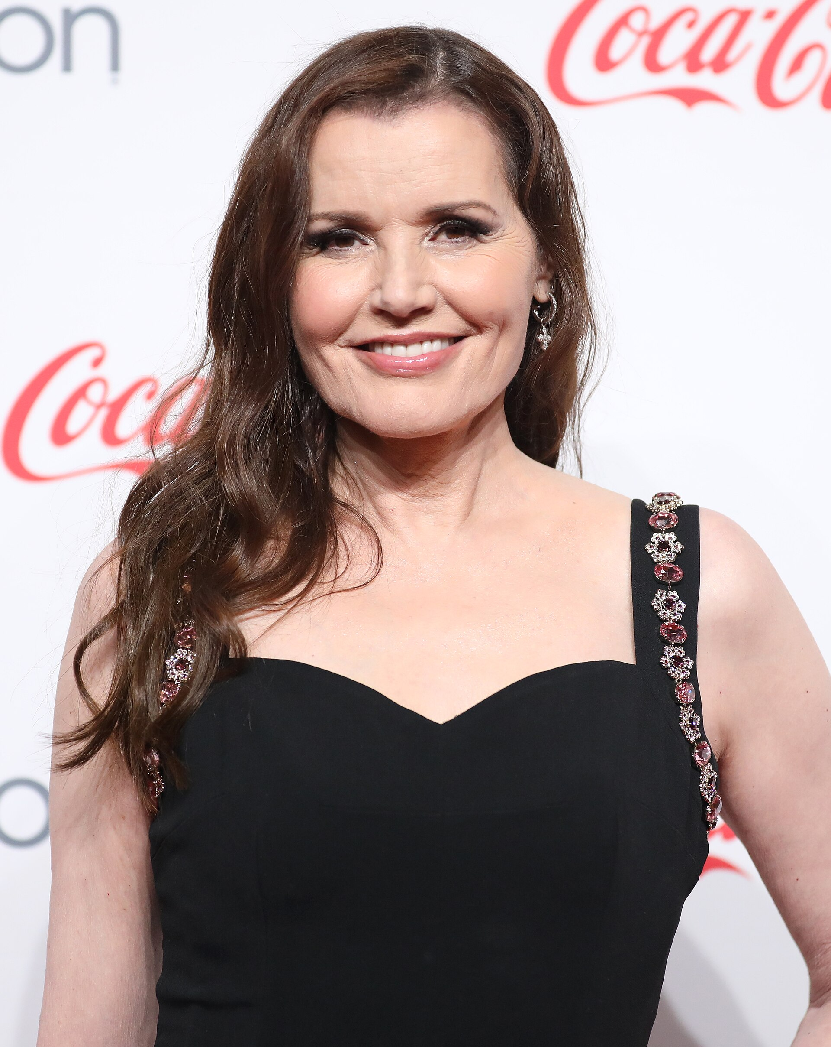
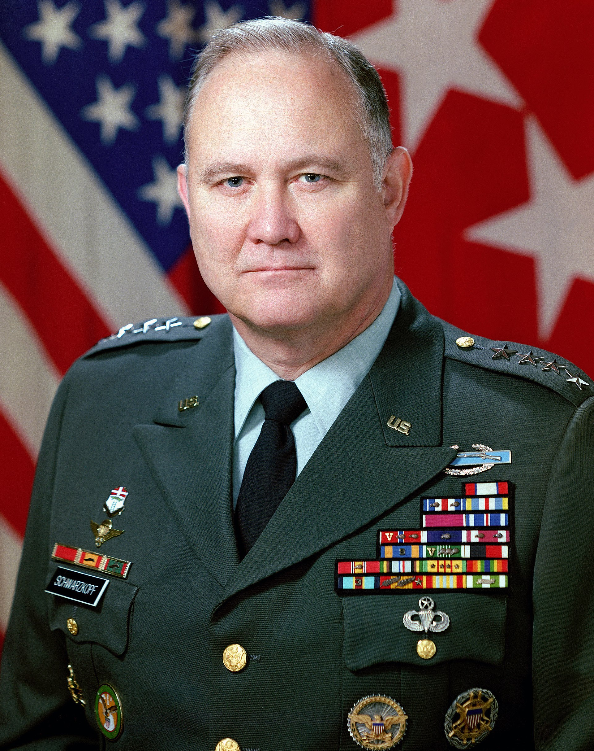
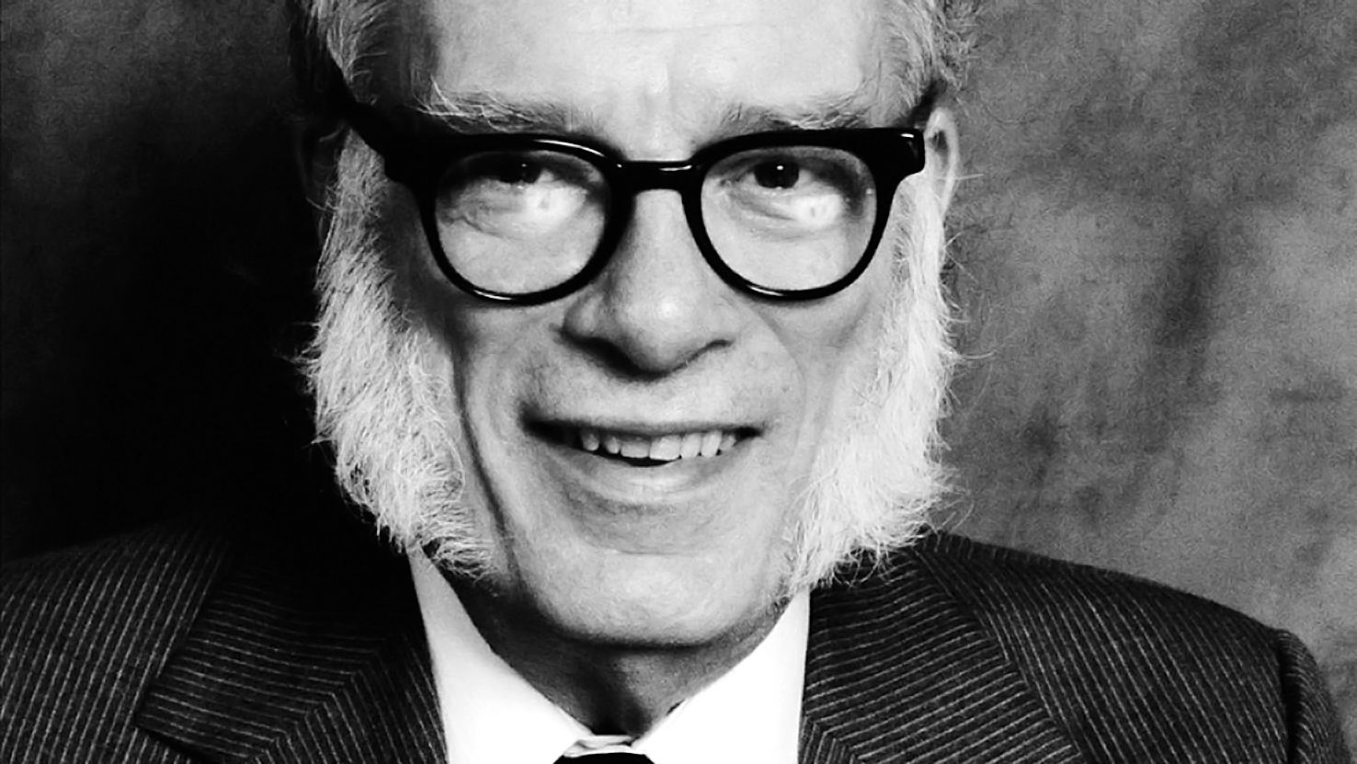
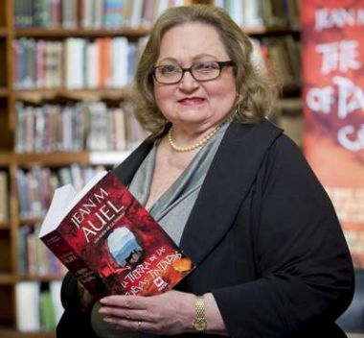
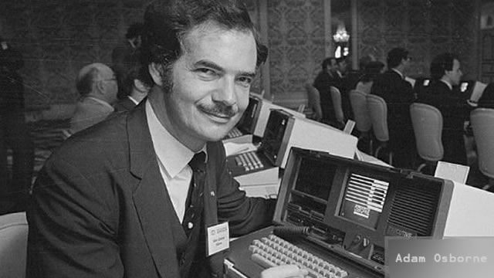
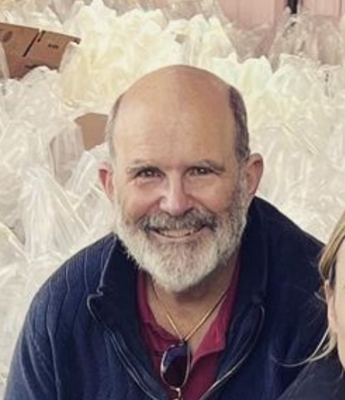
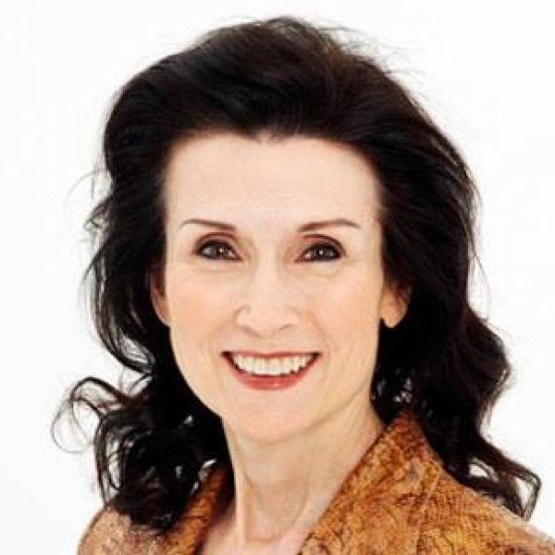
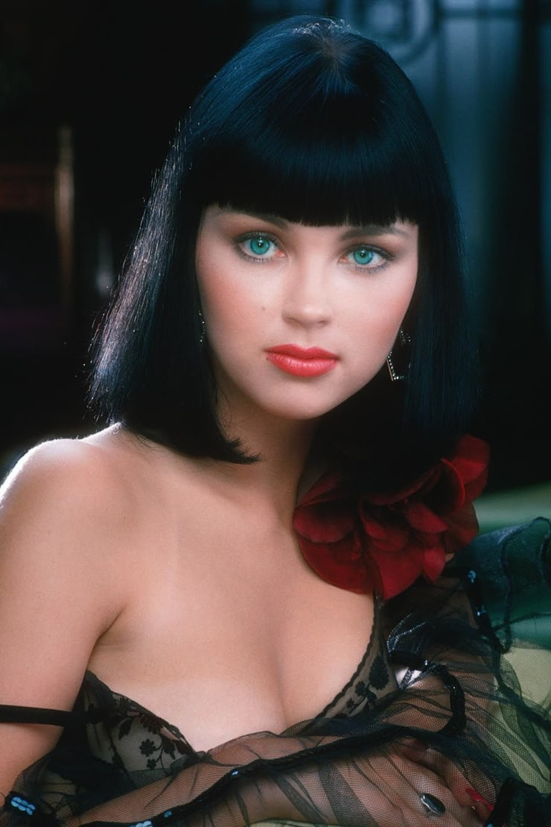
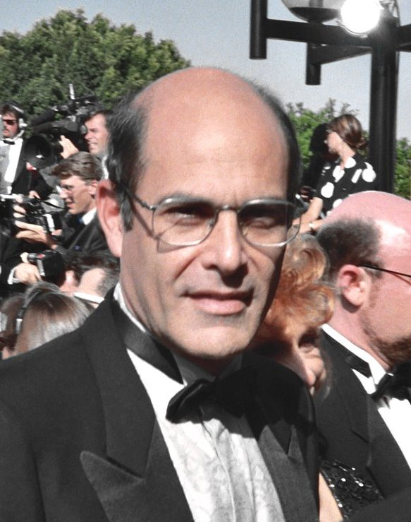
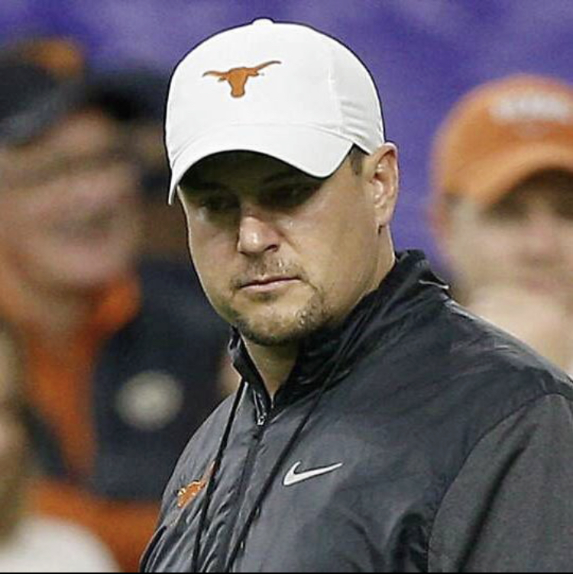
Who’s Who in Mensa
Notes:
Mensa has members of all ages and all professions. Last year, a two year old in Kentucky became the world's youngest member. American Mensa's oldest member is 102.
Here are some past and present Mensa members you might recognize:
Isaac Asimov, Greater New York Mensa
Jane Auel, Portland Mensa
General Norman Schwartzkopf, Jr
Alan Rachins from L.A. Law
Marilyn vos Savant from Parade Magazine
Tom Herman, Texas Longhorns coach
Geena Davis, actress
Katarina Souri, writer, singer, and Playboy Playmate
Adam Osborne, creator of the first portable computer and the Osborne effect
Finally, our own Nelson Crandall

Slide 10

Mensa Foundation
Vision
  The Mensa Foundation is where bright ideas, people, and resources converge to create solutions for a better world.
Mission
  Unleashing intelligence for the benefit of humanity
Notes:
Let’s talk about what Mensa does today.
While American Mensa is primarily a social organization, the loftier goals of the Mensa Constitution are pursued by the Mensa Foundation. The Foundation awards prizes to innovative thinkers, especially in the area of human intelligence. It awards over on hundred scholarships to college students. The Foundation also publishes the Mensa Research Journal three times a year, featuring scholarly articles and research.

Slide 11
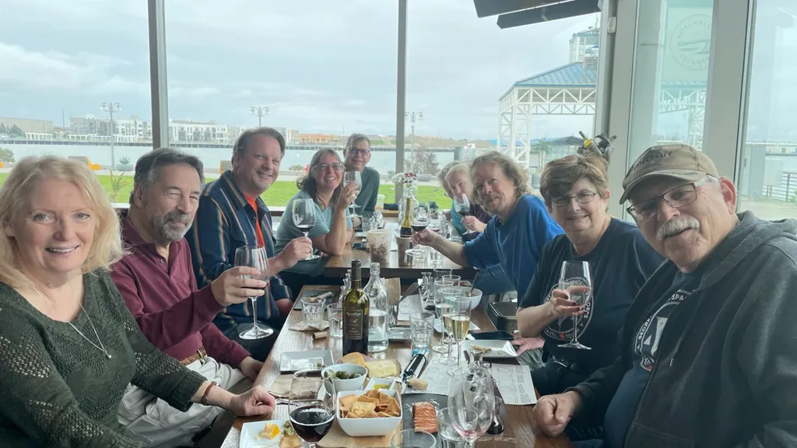
What does Mensa do?
Publications
    Mensa Bulletin — national publication
    Local Newsletters — SFRM Intelligencer
    Mensa Research Journal
Local meetings
    Lunch/dinner groups
    Games and trivia nights
    Picnic
Notes:
American Mensa publishes the Mensa Bulletin, sent to all US members. Our local group, San Francisco Regional Mensa, publishes the Intelligencer which includes a calendar of events. I have some extra copies which you are welcome to take.
San Francisco has one of the most extensive calendars of events in the country. We like meeting around meals or drinks for conversation, occasionally with a speaker. Games and trivia are popular. SFRM hosts spring and fall family- and dog-friendly picnics, a holiday party, and other activities. Most activities are organized by individual members.

Slide 12
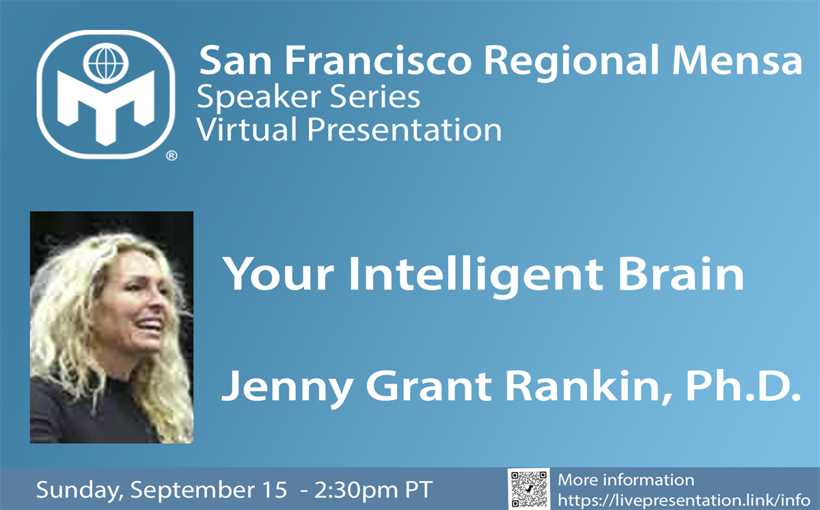
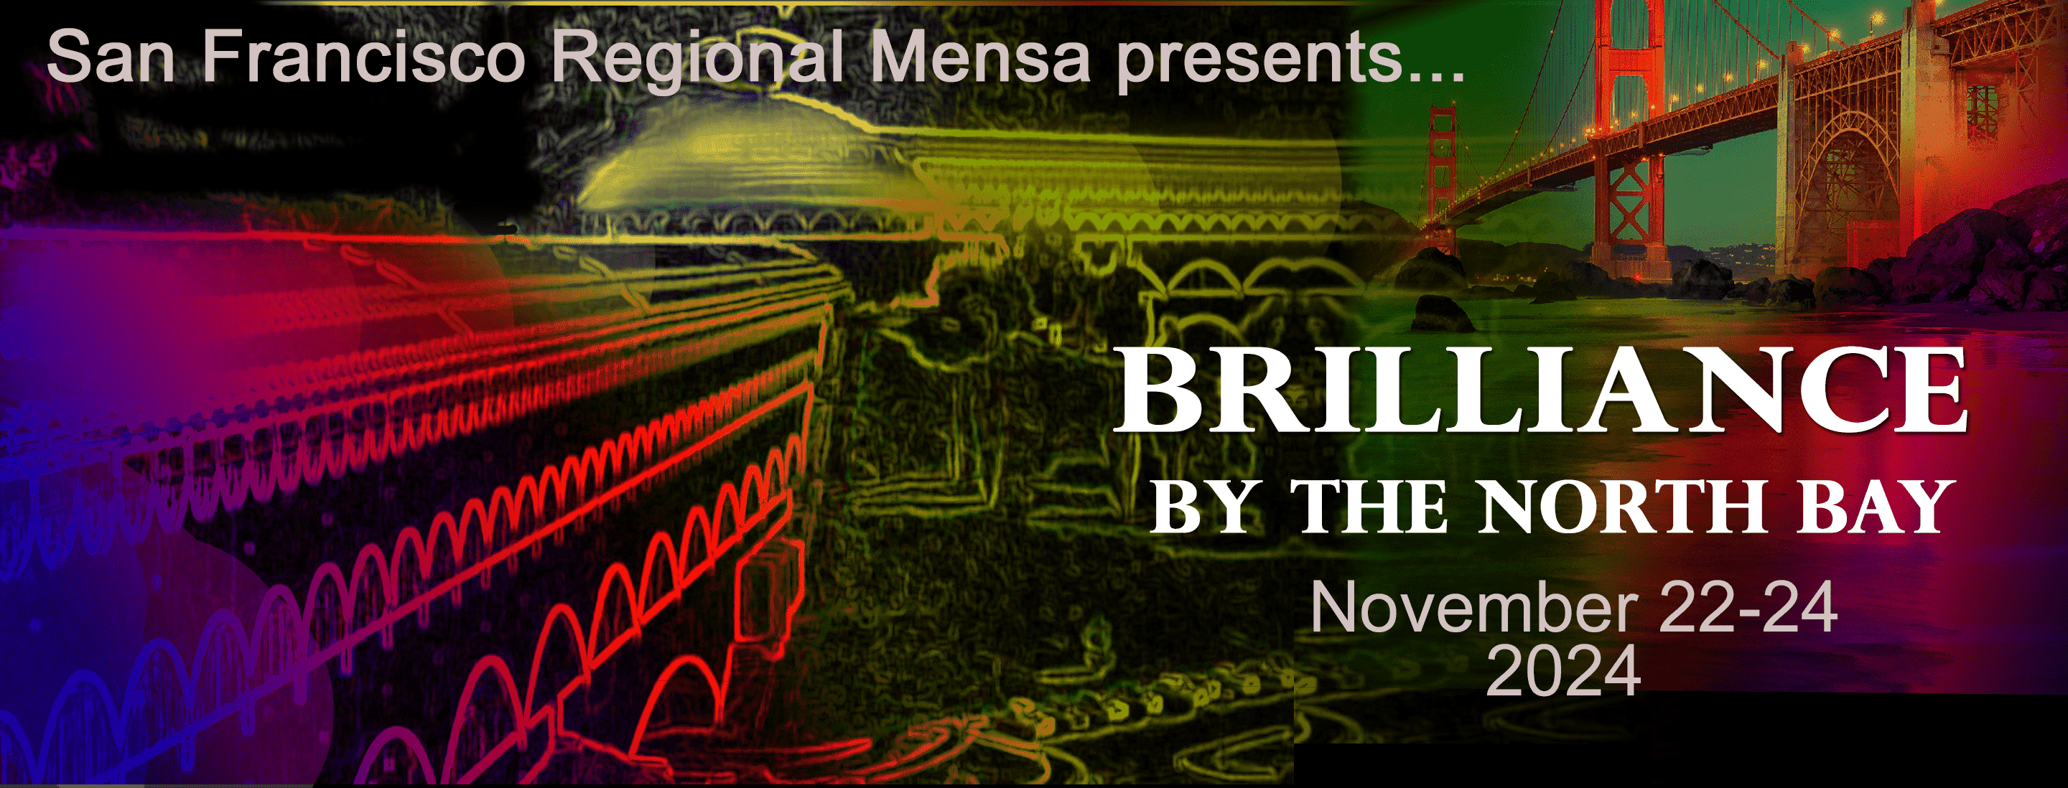
And there’s more
Virtual (online) meetings
    Book groups
    Speakers
    Chat groups
Special Interest Groups (SIGs)
123 Local Groups
Regional and National
Gatherings
Notes:
When the pandemic stopped all in-person meetings, we quickly shifted to online meetings. We have discovered that for many kinds of events, virtual meetings are more effective than in-person meetings. For example, for book reading groups and speaker presentations. I've been hosting a weekly "Sunday Check-In" on Zoom since the pandemic, where we have a small group of mostly regulars chat about anything and everything.
American Mensa has 144 Special Interest Groups for members who share interests ranging from beer to birding, polyamory to parapsychology.
There are 123 Local Groups, some large like SFRM, most small.
American Mensa holds an Annual Gathering each year, attracting more than a thousand members from across the country and many from other national Mensas. San Francisco Regional Mensa holds a Regional Gathering each November, with about 200 attendees from California and around the country. Many local groups have similar Regional Gatherings.

Slide 13
How to Join Mensa
Submit results from recognized IQ test
    American Mensa accepts scores from many standard IQ tests
    https://us.mensa.org/join/testscores
Take a locally proctored test
    SFRM (and other local groups) conduct testing sessions
    https://sfmensa.org/how-to-join-mensa
Take a test at a commercial testing center
    https://us.mensa.org/join/testing/private-testing
Notes:
Mensa has a single criterion for membership: scoring in the top two percent on recognized IQ tests.
There are several ways to join:
Provide prior evidence from a past IQ test. That's how I joined.
Take a proctored test scheduled by a local group.
Test at a commercial testing sites around the country.

Slide 14
Questions?
American Mensa: https://us.mensa.org
San Francisco Regional Mensa: https://sfmensa.org
Michael Eager, Region 8 Vice Chair: rvc8@us.mensa.org
Notes:
Here is contact information for me, American Mensa and our local group, San Francisco Regional Mensa.
Thank you.
I think we have time for a few questions.

